Slide 1
ELECTRON DISPLACEMENT EFFECTS IN COVALENT BONDS
Class B.Sc. – I Sem – I

Slide 2
RECAP!!
A functional group is an atom or a group of atoms bonded together in a unique manner which is usually the site of chemical reactivity in an organic molecule.
The order of decreasing priority for some functional groups is:
-COOH, –SO₃H, -COOR (R=alkyl group), COCl,
-CONH₂, -CN,-HC=O, >C=O, -OH, -NH₂, >C=C<,
-C≡C- .

Slide 3
FUNDAMENTAL CONCEPTS IN
ORGANIC REACTION MECHANISM
In an organic reaction, the organic molecule reacts with an appropriate attacking reagent and leads to the formation of one or more intermediate(s) and finally product(s)
.
Reaction Mechanism: A sequential account of each step, describing details of electron movement, energetics during bond cleavage and bond formation, and the rates of transformation of reactants into products (kinetics).
ORGANIC MOLECULE
(SUBSTRATE)
INTERMEDIATE
PRODUCT
BY PRODUCT

Slide 4
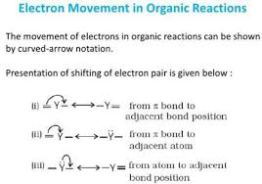
ELECTRON MOVEMENT IN ORGANIC REACTIONS
Electron movement in organic reactions takes place as shown below:

Slide 5
ELECTRON DISPLACEMENT EFFECTS IN COVALENT BONDS
The electron displacement in an organic molecule may take place either in the ground state under the influence of an atom or a substituent group or in the presence of an appropriate attacking reagent.
The electron displacements due to the influence of an atom or a substituent group present in the molecule cause permanent polarization of the bond.
Permanent Electron Displacement effects are seen in Inductive Effect, Resonance Effect.
Temporary Electron Displacement effects are seen in Electromeric Effect.

Slide 6

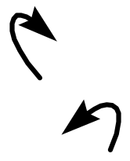
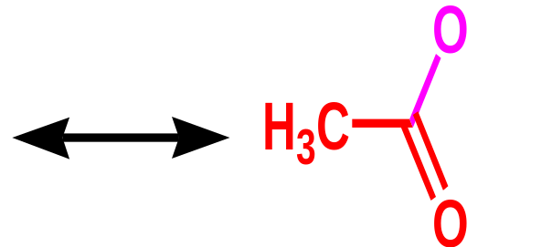
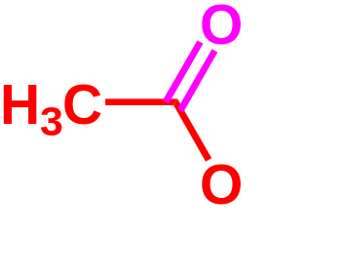

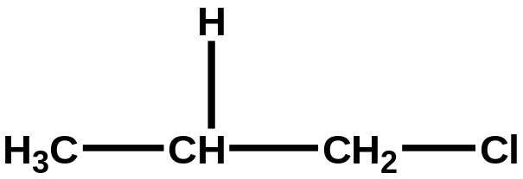
INDUCTIVE EFFECTS
δ+
δ+
δ+
δ-
δ+

Slide 7
Electronegativity Values
H 2.1 | C 2.5 | N 3.0 | O 3.5 | F 4.0
 | Si 1.8 | P 2.1 | S 2.4 | Cl 3.0
 |  |  |  | Br 2.8
 |  |  |  | I 2.5

Slide 8
INDUCTIVE EFFECT
Inductive effect may be defined as the permanent displacement of electrons forming a covalent bond towards the more electronegative element or group.
The inductive effect is represented by the symbol, the arrow pointing towards the more electronegative element or group of elements.

Slide 9
INDUCTIVE EFFECT
In case of 1-Chloro Butane inductive effect may be represented as below.
The C-Cl bond is a Polar Covalent Bond.
This polarization results is partial positive charge (⁺) on Carbon-1 and Partial Negative Charge (⁻) on Chlorine.
The shift of electron density is shown by an arrow that points from ⁺ to ⁻ end of the polar bond

Slide 10
INDUCTIVE EFFECT
In turn Carbon-1 draws some Positive charge(⁺) towards it from the adjacent C-C bond .
In this way the polar C-Cl bond induces polarity in the adjacent bond.
Such polarization of -bond caused by the polrisation of the adjacent -bond is called Inductive Effect.
This effect is passed on to the subsequent bonds also but the effect decreases rapidly as the no.of intervening bonds increases.

Slide 11
INDUCTIVE EFFECT
The Inductive effect is related tot eh ability of Substituent(s) to either withdraw or donate electron density to the attached carbon atom.
Based on the ability, the substituents can be classified as electron donating groups or electron withdrawing groups relative to Hydrogen.
Some examples to electron –releasing groups:
-CH₃ (Methyl), - CH₂-CH₃ (Ethyl Group) etc.
Some examples to electron –withdrawing groups:
-X, -NO₂ (Nitro Group), -CN (Cyano Group),
-COOH (Carboxy Group), -COOR (Ester Group),
-OAr ( Aryloxy Group) etc.

Slide 12
TYPES OF INDUCTIVE EFFECT
If the substituent “Y” bonded to Carbon atom is ELECTRON RELEASING then Y atom acquires +ve charge and such Inductive effect is termed as +I Effect.
If the substituent “X” bonded to Carbon atom is ELECTRON WITHDRAWING then Y atom acquires
-ve charge and such Inductive effect is termed as
-I Effect.
C
Y
Y= Electron releasing Group.
C
X
X= Electron withdrawing Group.

Slide 13



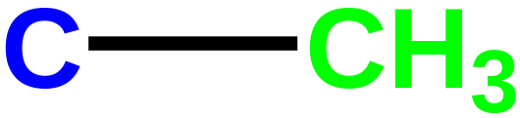
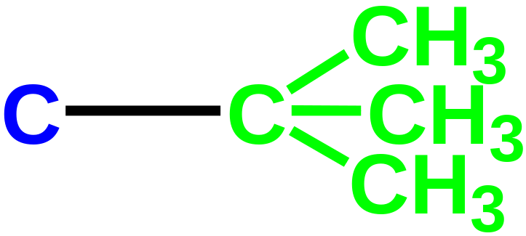

Bond Polarisation and Inductive Effects
-
-I Inductive Effects
+I Inductive Effects
δ+
δ-
δ-
δ+
δ+
δ-
δ-
δ+
δ+
δ-
δ-
δ+

Slide 14
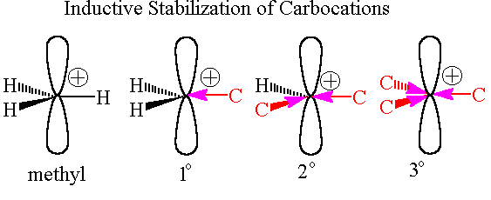

Inductive Effects:
Short Range Nature of Inductive Effects
Carbocation Stability
The More Carbons adjacent to Cation Site, the more stable is the Cation. Because Carbon releases electron density better than Hydrogen

Slide 15
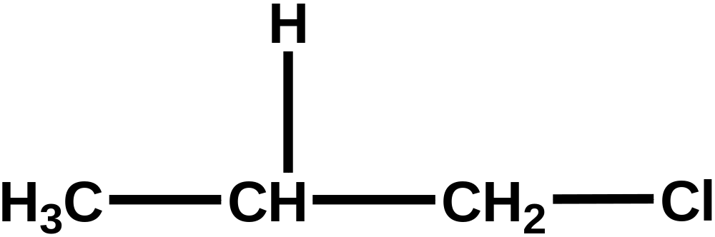
Inductive Effects are Short Range
In Contrast to Resonance Effects
This proton is acidic.
δ+
δ-
δ+
δ+
δ+
The polarised C-Cl bond transmits further polarisation through the σ-bond framework,
But effect drops off quickly…

Slide 16
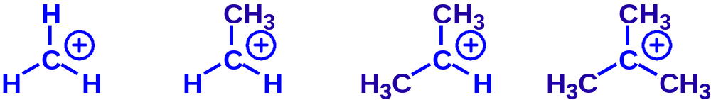
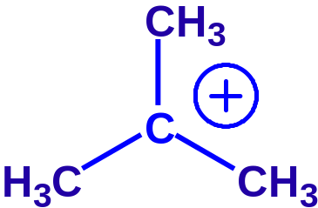
Inductive Effects and Carbocation Stability
LEAST
STABLE
MOST
STABLE
Methyl
Carbocation
Primary
Carbocation
Secondary
Carbocation
Tertiary
Carbocation
Carbon atom is electron deficient (only has 6 electrons in its outer valence).
The methyl groups have +I inductive effects.
Thus, extra electron density is ‘pushed’ onto the carbocation, which stabilises the carbocation.

Slide 17
HOME ASSIGNMENT
1) Using the curved arrow notation, show the formation of reactive intermediates when the following covalent bonds undergo heterolytic cleavage.
CH₃-CN, CH₃-SCH₃, CH₃-Cu
2) Which bond is more polar in the following pairs of molecules:
a) H₃C-H or H₃C-Br b) H₃C-NH₂ or H₃C-OH
c) H₃C-OH or H₃C-SH.
3) In which C-C bond of CH₂CH₂CH₂Br, the inductive effect is expected to be the least? Explain with reason.

Slide 18


