Slide 1
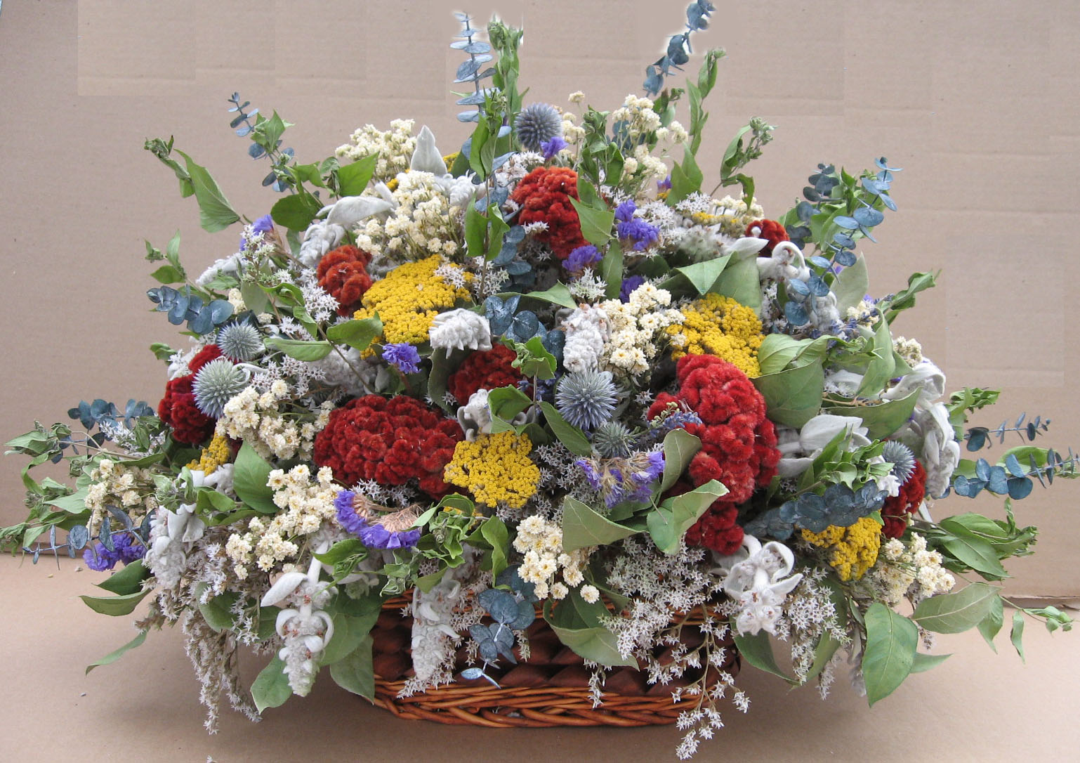
FLOWER ARRANGEMENT
PRESENTED BY:-
RANJANA NAXINE.
DEPARTMENT OF HOME ECONOMICS.
P

Slide 2
Introduction
Flower arrangement is an art in which an attempt is made to arrange flowers , foliage ,plants and flower vases in such a way that all of these when arranged produce a harmonious appearance, texture and color combination.
Main objective is to make the place where it is to be placed cheerful, lively and beautiful.
It expresses one’ love for beauty

Slide 3
Elements Of Art
Line-refers to shapes which move the eye along, up and down or in different directions.
Lines have a great power of expression
Straight lines-sense of dignity
Horizontal lines peaceful
Curved lines –grace and sophistication
Diagonal lines-show speed
Lines are provided by stems and branches

Slide 4
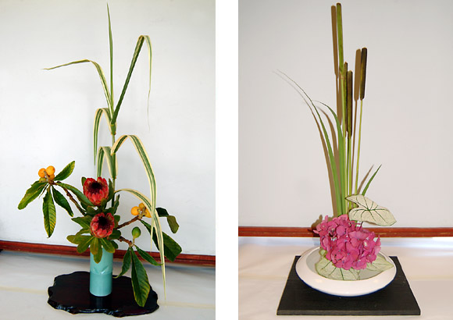

Slide 5
Elements of art (contd)Line
Outline of flower arrangement-basic shapes like circle, sphere, triangle etc
The container chosen should have the same line movement so that arrangement appears as one unit
Flower vase taken as trunk of tree, lines of flowers radiating look natural branches of tree.The whole arrangement should look like a tree

Slide 6
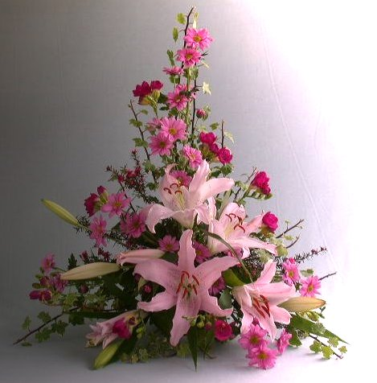
Form-Many shapes can be seen in plant material like round flowers, oval leaves etc
Forms refer to outline of flower arrangement
Forms provide resting place in flower arrangement
Dominant forms hold eye at one place in flower arrangement
Large rounded flowers should be arranged in the centre and low level in flower arrangement
Long and slender flowers at highest level and medium ones in centre

Slide 7
Texture –refers to feel of things-surface and structure of plant material. Unity in texture between plants themselves and flowers and containers.
Flowers with fine texture should be arranged in delicate containers and rough texture in metal or clay vases.
Texture influences color. Rough texture makes color look darker.
Texture associated with certain expressions-rough texture associated with masculinity, informality and smooth texture with femininity and elegance.

Slide 8
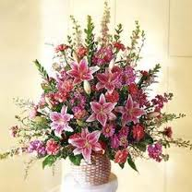
Colour-Color produces many types of effects
Color can appear warm or cool-A warm colored flower arrangement having red – orange flowers will look wonderful on a cold day and blue violet on a hot day
Some colors are more visible in dim light than others like white ,yellow yellow green are suitable for dark corners.
Advancing colors like red suitable for large rooms and receding colors like blue, violet for smaller rooms.
If three colors are used one should be dominant and followed by second and then third.
Light colored flowers in upper part and dark colored towards bottom and centre.

Slide 9
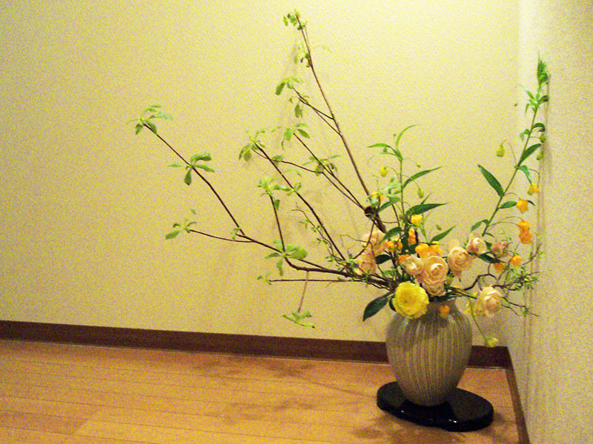
Space-Each flower-arrangement can be visible if there is sufficient space around it.
Space at the place of arrangement-tall narrow corner requires a tall arrangement.
Space within design-less space in mass arrangement and more space between flowers in line arrangement.
Space below flower arrangement-with help of raised container or pedestal or stand.

Slide 10
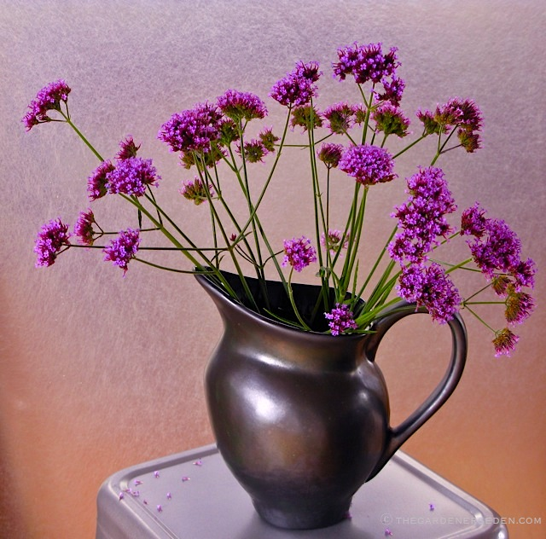
Principles Of Art and Flower Arrangement:
Rhythm – Growing things have their own rhythmic growth movements. All types of rhythms are based on movements and repetitions. Rhythm and flower arrangement is obtained when our eyes travel easily around the whole arrangement.
Types of Rhythm:
Radiating Rhythm
Curvilinear Rhythm
Diagonal Rhythm

Slide 11
Proportion – Good proportion refers to suitable amount and size of things in relation to each other and surroundings.
Each piece of plant material should be related to others in relation to size, e.g. Dalia cannot be used with sweat pea or rose.
Plant material should be in relation to the size of container. E.g. Sunflower or dalia does not look appropriate in wine glass.
The plant material should be one and half times the height or the width of the container.
Accessory should be used in proportion to the flower arrangement.
The whole arrangement should be in proportion to the place where it is kept.

Slide 12
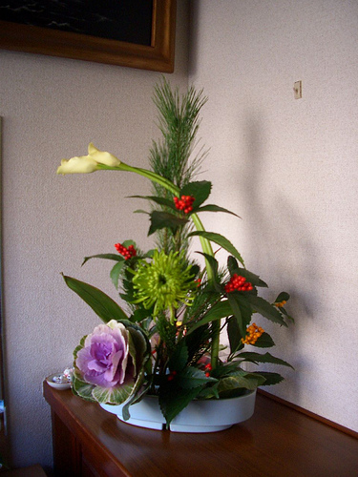

Slide 13
Balance – To achieve good balance in flower arrangement the eye should be attracted to both sides of the design. Not necessarily the plant material but maybe flowers on one side and long branch on the other. To get balance arrangement, heaviest mass of flower material, largest flowers and longer stems to be placed in the center of the container.
Two types of Balance –
Formal Balance : When its shape is exactly the same on either side of the center.
Informal Balance : When plant material placed on either side is not exactly in the same position but attention is equally attracted on both sides of the design.

Slide 14
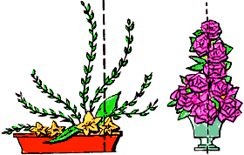

Slide 15
Emphasis – For emphasis, attention is drawn to the center of interest, whether flowers are larger, more numerous, contrast or brilliant in colour.
Harmony – Means unity
Signifies that flowers and flower vase should have unity with respect to shape, colour and texture of the whole unit. E.g. Roses look nice in glass flower vase.

Slide 16
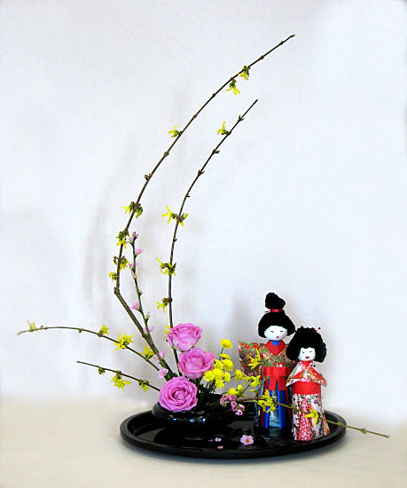
Types of Flower Arrangement
Line arrangement – Originated in east, particularly in Japan. Require very little plant material. The arrangement consists of three sprays of different lengths that go in the same or somewhat similar direction. E.g Ikebana. More stress is given to line emphasis, asymmetrical balance etc.

Slide 17
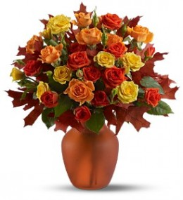
Mass arrangement
Basically traditional,
large amount of plant material is used, grouping of colours and flowers is emphasized. This type of arrangement is used for large formal parties.

Slide 18
Line and Mass Arrangement
This type of arrangement is of American origin. It combines the best features of line and mass arrangement. Different kinds of popular shapes are triangle, pyramid, s-curve, etc.

Slide 19
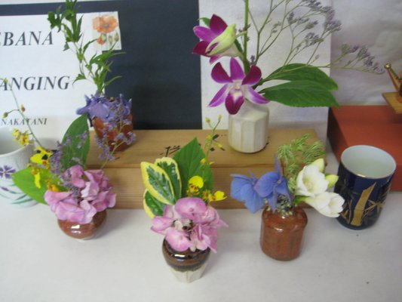
Miniature arrangement
Small arrangements are made with small flowers are made with small flowers in tiny containers such as ash trays, dainty bottles etc Arrangement should not be more than five inches

Slide 20
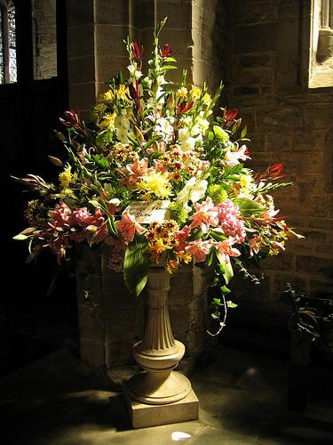
Pedestral Flower arrangement
The arrangement is done in a container on a stand.
The height of arrangement can be 3feet or more.
Arrangements are used for parties

Slide 21
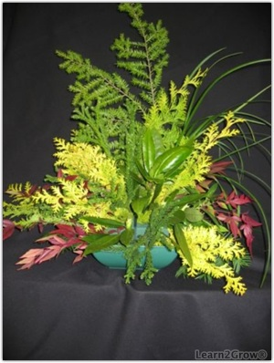
Foliage Arrangement
Consists of different foliage of of various sizes and shapes.
Arrangements are more long lasting than flowers
Emphasis can be created by choosing various colours and sizes of leaves

Slide 22
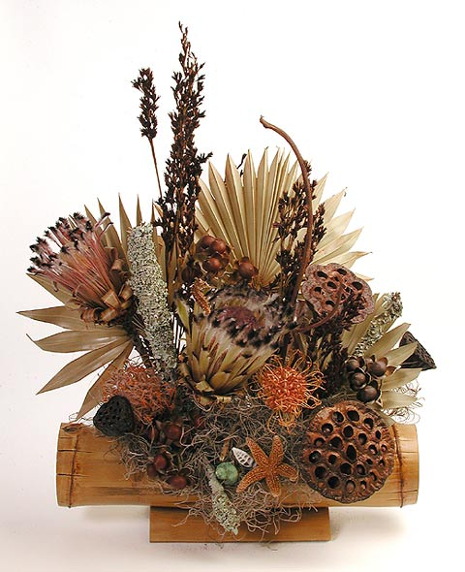
Dry Flower Arrangement
Natural material is dried before use.
These arrangements are long lasting
Various kinds of material are used eg wheat ,cotton and maize pods dried twigs

Slide 23
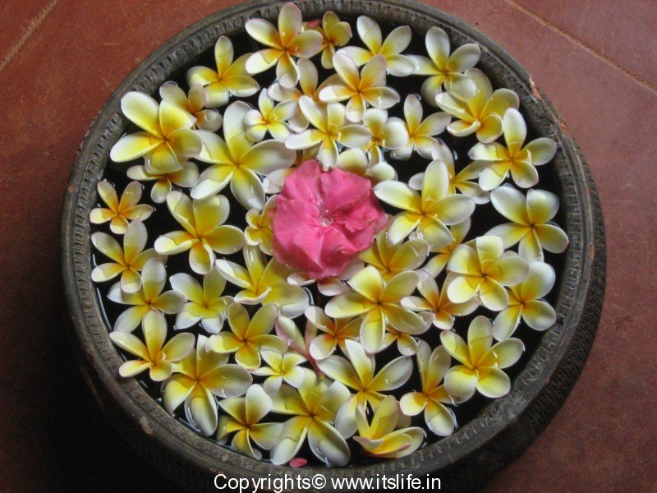
Floating Arrangement
In floating arrangement stems of flowers and stems cut.
Light weight and small flowers used
Flat or shallow containers used
Floating diyas can be added

Slide 24
Points to be kept in mind while making a flower arrangement
Placement-Flowers last longer when kept in cool and shady place
Large arrangements in large rooms and small arrangements in small rooms
Flower arrangement should not hide beauty furnishings of room
Flower arrangement should not be placed in front of the window with light behind.

Slide 25
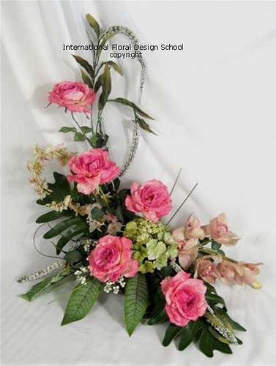
Size-After deciding position judge the amount of space available to keep arrangement
If large wall then arrangement on pedestal
Flower arrangement should be small in dining room
Container and plant material according to size of arrangement

Slide 26
Shape-A low coffee table will require a low arrangement
Shape of table also suggest shape of flower arrangement
A round table will look best with arrangement of similar type
Colour-Colour scheme of room is important in deciding colour of flower of arrangement
Many colours in room then monochromatic colour scheme for flower arrangement
Dull room need more variety in the colour of flowers
Hot weather cool colours andin cold climate red and orange colours look cheerfull and warm

Slide 27
Style-Traditional arrangement in traditional drawing room
Harmony can be achieved when arrangement goes well with other furnishings in room
Lighting-Good lighting improves appearance of any flower arrangement
Fluorescent lights harmful for flowers tungsten electric lighting is better
Candle light for evening meals
Yellow, orange and white preferred in dim light

Slide 28
Special Occasions-For buffet setting-Buffets in large rooms so large arrangement
Offices-Flower arrangement should not interfere with work it should have a cheering influence on workers-neat and simple
Hall –Large arrangements on pedestal are effective

Slide 29
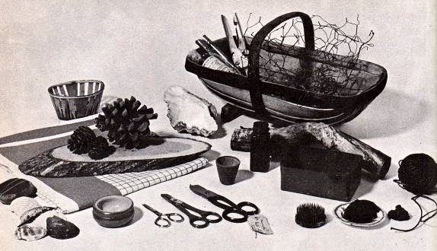
Necessary Equipment for flower arrangement
1- Cutting tools-secateurs- special type of scissors used for cutting woody stems
Light weight scissors
Knife
2-Equipment for handling material
Buckets
Jugs
Watering can
3-Containers

Slide 30
4-Supports for flowers-
Pin holders
Mesh wires
Sand
Oasis
Stub wires
5-Accessories

Slide 31
Care and Selection of flowers for flower arrangement
Pluck flowers either in morning or late evening
It is better to select buds or half bloom flowers
Dip plant material in water immediately
Never expose plant material to direct sunlight
Change water on daily basis
Make slanting cuts
Stems should be trimmed
Tallest stem should be 1 ½ times height or width of container
For tall containers 3 ½ times in length of container
Flowers stay longer if aspirin is added
Largest flowers, bright colours and tallest stems should be used in centre or at base

Slide 32
