Slide 1
PHOTOPERIODISM
The biological measurement of the relative lengths of day and night

Slide 2
Photoperiodism
Photoperiodism the response by an organism to synchronise its body with changes in day length
At high latitudes this is important because the change in length of the day indicates the season
Days getting shorter indicate winter is approaching
Days getting longer indicate summer is approaching
Some plants regulate their flowering this way
© 2010 Paul Billiet ODWS

Slide 3
The control of flowering
Change in day length
Photoperiod mechanism in the leaves
“Florigen” hormone
Flower buds
Flowering
© 2010 Paul Billiet ODWS

Slide 4
Response to day length
Response varies according to the age of the plant and varies in its intensity
Broadly they can be grouped into three categories
© 2010 Paul Billiet ODWS

Slide 5
Response to day length
RESPONSE
DAY LENGTH
EXAMPLES
LONG-DAY PLANTS
>9-16 h
Red clover > 9h
Oats > 12h
Winter wheat > 12h
SHORT-DAY PLANTS
(“LONG-NIGHT” PLANTS)
< 10-16 h
Chrysanthemum < 15h
Tobacco < 14h
DAY-NEUTRAL PLANTS
Do not respond to day length
Cucumber
Holly
Maize
© 2010 Paul Billiet ODWS

Slide 6
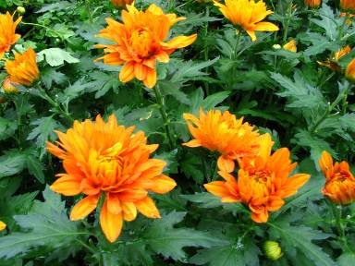
Response to day length
Some plants flower only after a CRITICAL DAY LENGTH
Some plants only flower after a CRITICAL NIGHT LENGTH
Image Credit: Chrysanthemum
© 2010 Paul Billiet ODWS

Slide 7
The night break phenomenon
For plants with a critical night length, a short flash of light in the middle of the night would make the plant behave as if it had been exposed to a long day
© 2010 Paul Billiet ODWS

Slide 8
The quality of the light
The wavelength of the light used is important
Colour
Wavelength
SHORT-DAY
LONG-DAY
Far red light
>700nm
Stimulates
Reverses
Red light
670 – 680nm
Inhibits
Stimulates
© 2010 Paul Billiet ODWS

Slide 9
The pigment
This indicated that there should be a pigment that absorbs red light
(in other words this pigment should be blue-green)
This pigment is the mechanism capable of recognising changes in day length
PHYTOCHROME
© 2010 Paul Billiet ODWS

Slide 10
The photoperiod mechanism
Phytochrome exists in two versions which are inter-convertible
P_{R} that absorbs red light
P_{FR} that absorbs far red light
RED LIGHT
P_{R}
P_{FR}
FAR RED LIGHT
© 2010 Paul Billiet ODWS

Slide 11
In the short-day plant
P_{FR}
P_{R} builds up
Darkness (slow)
Far red light (fast)
Short-day plants
FLORIGEN
Activated
FLOWERING
© 2010 Paul Billiet ODWS

Slide 12
In the long-day plant
Sunlight
Red light
P_{FR} builds up
P_{R}
Long-day plants
FLORIGEN
Activated
FLOWERING
© 2010 Paul Billiet ODWS

Slide 13
Summary
Sunlight
Red light
P_{FR} builds up
P_{R} builds up
Darkness (slow)
Far red light (fast)
Long-day plants
Short-day plants
FLORIGEN
Activated
FLORIGEN
Activated
FLOWERING
FLOWERING
© 2010 Paul Billiet ODWS

